Slide 1
PIP Case Review Removing the Questions section from the prototype
Martin Gray - Team Starling

Slide 2
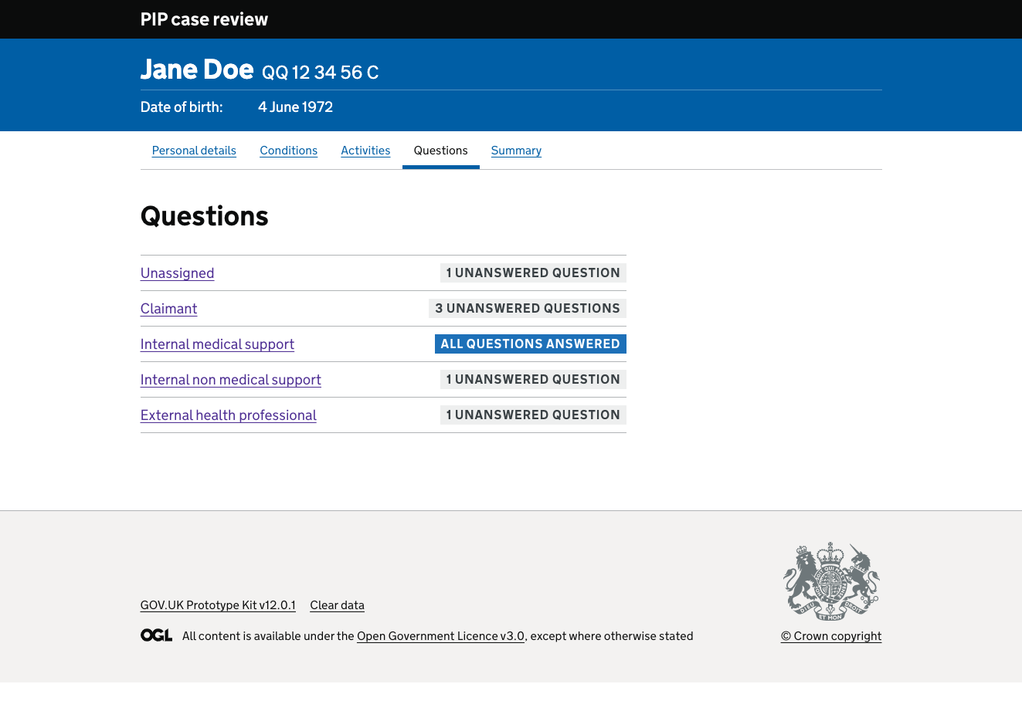
Questions: first page
Our prototype enables a case manager to review each of a Claimants conditions and the activities they are claiming for.
The case manager could write a question on each and assign it to a claimant, internal medical support, internal non-medical support or an external healthcare professional.

Slide 3
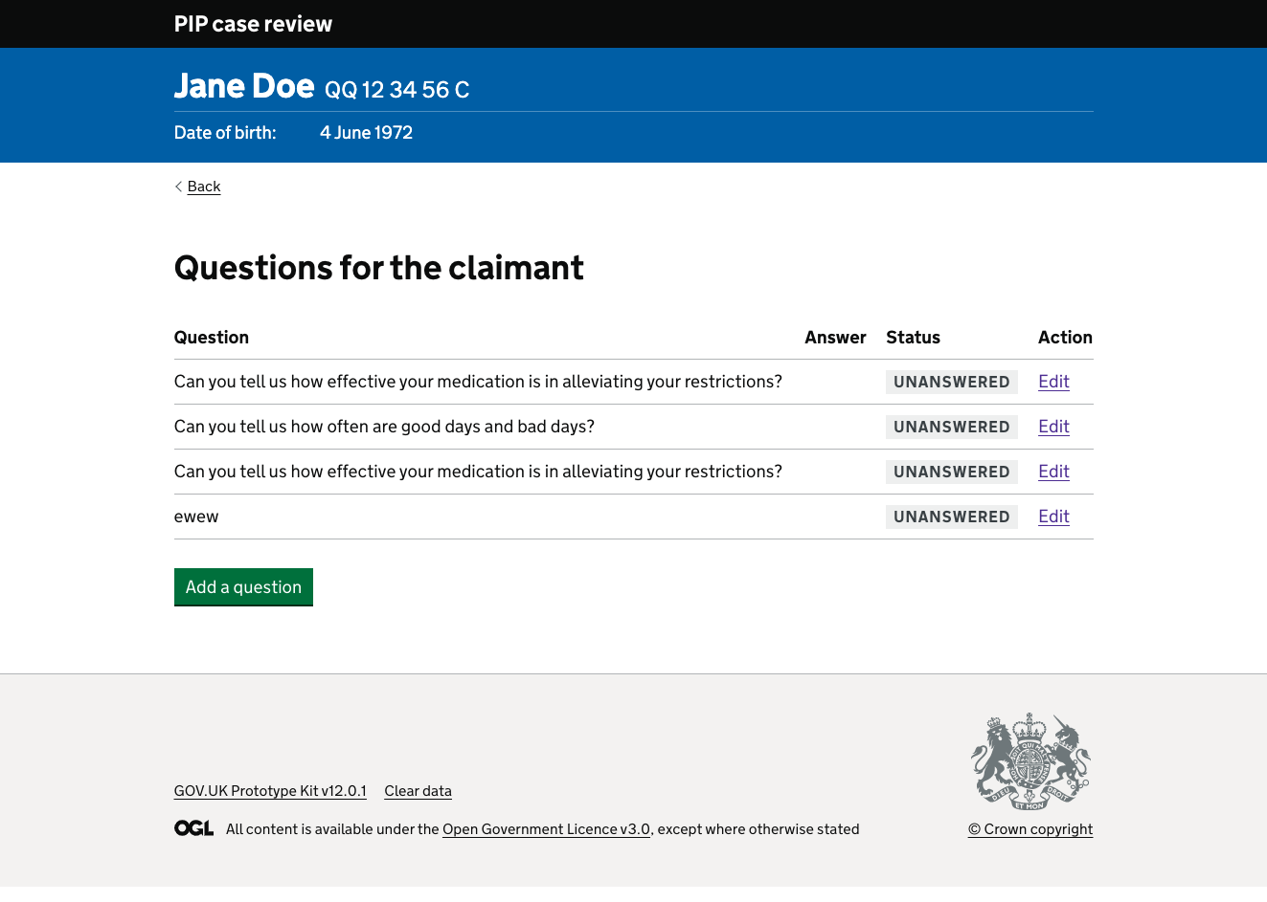
Questions for the claimant
The question section would group the questions by whom they have been assigned to, enabling them to be answered whilst on a call with that person.
They could also add new questions and answer them whilst on the call.

Slide 4
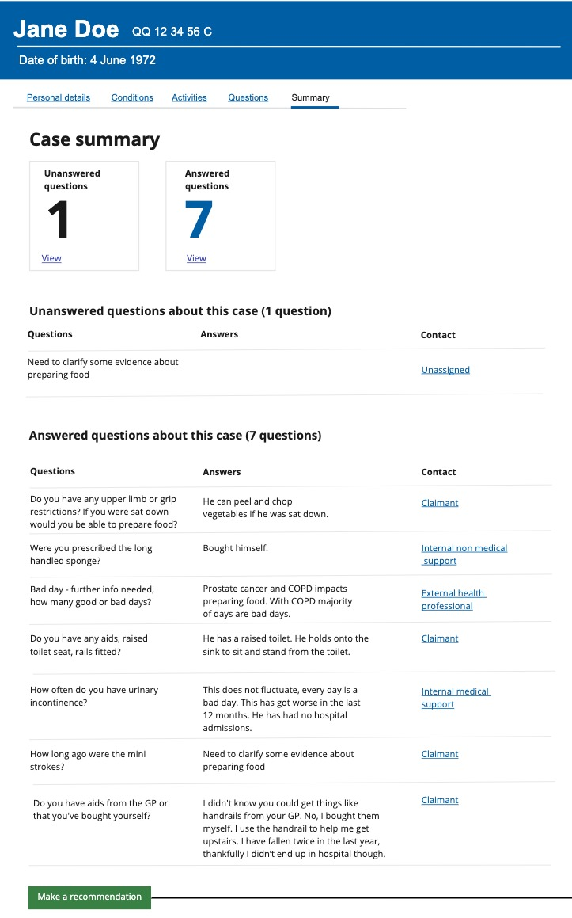
Summary page
The summary page provided an overview of the questions, any answers before a Case Manager recommends the case for a decision or an assessment.

Slide 5
User research indicated that:
case managers often just scribbled the answers down in shorthand or on a word doc and typed them up later as it wasn’t easy to do this whilst on a call.
the whole Questions were duplicated on the Summary page.
the journey to navigate around each question was considered too complicated for example if the case manager began on a question for claimant page and created a new question for the Internal medical support, that would be a lot of clicks, and would the journey end be the internal medical support questions page or the claimant questions page?
adding any new questions in the question section meant that it was not attached to an activity or condition and difficult to trace.

Slide 6
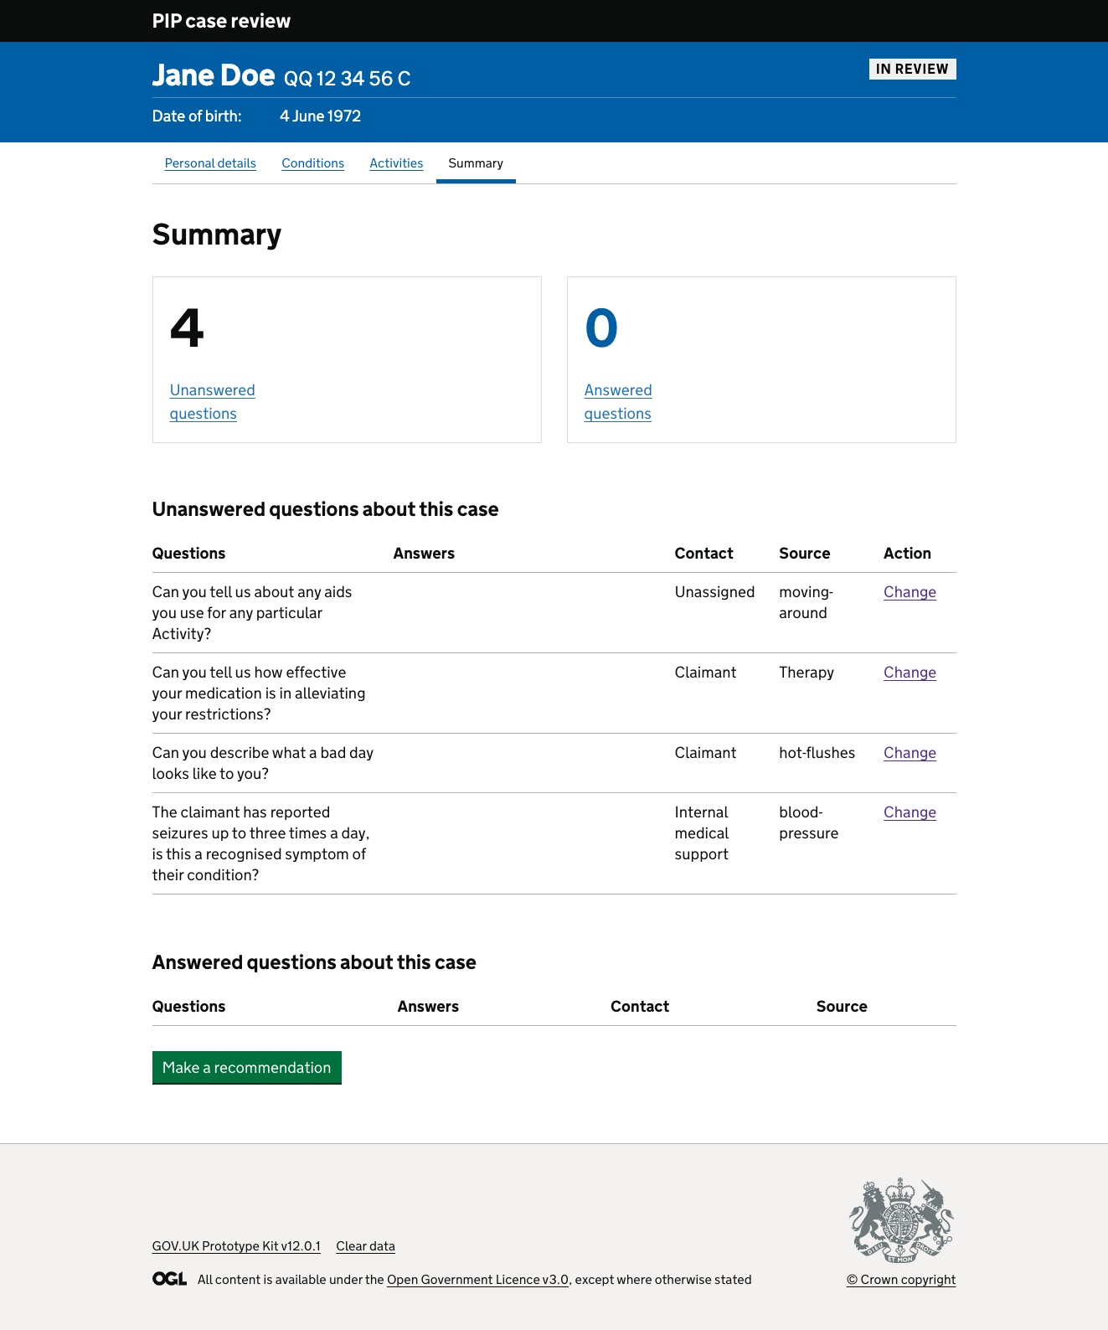
Conclusion
So we made the team decision to:
remove the Questions section
add the ability to answer questions from the summary page
add the ‘source’ to this page -this is the name of the condition or activity where this question was created.
group the question by who was contacted.

Slide 7
The benefits of this are:
All questions are displayed together
It makes the journey shorter for the case manager.
It is less complicated to navigate a case as there is no confusing question journeys
Questions would always be linked to an activity or a condition (source).
The summary page with the numbers of unanswered and answered questions at the top is more visually appealing.
We will test this and get some user feedback soon!

